Slide 1
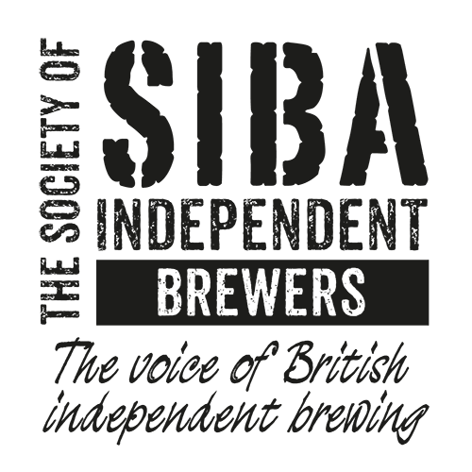
Small Breweries’ Relief
Proposals for Reform

Slide 2
About SIBA
SIBA, the Society of Independent Brewers was established in 1980 to represent the interests of the growing number of independent breweries.
SIBA was instrumental in helping Government establish small breweries relief, which came into force in 2002 after 20 years of campaigning.
SIBA now represents 750 breweries83% of SIBA members say that SBR is ‘extremely important’ for their businesses with a further 13% as ‘very important’ or ‘important’.

Slide 3
Why did Government introduce SBR?
Among the factors influencing the then Government’s decision to introduce reduced rates
of duty for small brewery beer in 2002 were, in their own words:
The poor profitability of small breweries relative to larger breweries which enjoy better economies of scale of production;
The difficulties faced by small breweries in bringing their goods to market and in competing with larger breweries which could offer bigger discounts to wholesalers; and
The importance of maintaining diversity within the beer industry and preserving choice for the consumer.
“[Government wants] to encourage one group of small businesses: the nation's small brewers - often village pubs, some two centuries old - I have decided that the duty paid on their own beer will be halved: a cut equal to 14 pence off each pint to be implemented for village pubs and small breweries by this summer - in time for the World Cup.”
Rt Hon Gordon Brown MP, 2002 Budget speech
http://webarchive.nationalarchives.gov.uk/20090221115049/http://customs.hmrc.gov.uk/channelsPortalWebApp/downloadFile?contentID=HMCE_PROD_008216

Slide 4
SIBA’s principles
SBR should promote:
A sustainable brewing industry
Growth and opportunities for small breweries
Fairer competition
A more diverse and innovative UK brewing industry

Slide 5
SIBA objectives for SBR reform
SBR should:
Promote entrepreneurship and innovation in brewing
Enable small brewers to invest in growth and job creation
Broaden consumer choice
Enable small brewers to meet the demands of today’s beer drinkers in fair competition
Not constrain normal corporate market activity
Widen the geographical distribution of the brewing industry (promoting localism) supporting local economies and jobs
Exert downward pressure on the full beer duty rate
Be easy to understand and simple to operate

Slide 6
Other specific areas of reform SIBA is calling for:
Support for an industry-led review at least every five years to ensure SBR continues to work well and promotes sustainability in the sector.
New measures to encourage normal mergers and acquisitions activity.
Removal of exports from the SBR calculation to encourage export activity subject to legal advice.

Slide 7
This chart shows the three models overlaid.
HMRC current, SIBA model F and the Coalition model.
The higher a point on the curve, the higher % duty paid.
The steeper the curve, the faster SBR is withdrawn as a brewer grows.
Above the blue line means a higher rate of taxation, below means a lower rate.
Note: bottom scale is not linear.

Slide 8
SIBA’s model maintains 50% relief up to 5k HL.
The Coalition model withdraws relief sharply for all brewers from 1k hl – 5k hl
And does so between 5k and up to 6k, too.
Because SIBA curve is lower than any other curve, it means no brewery loses out.
The Coalition model is taking from small brewers to fund policy for larger brewers above.
HERE

Slide 9
Within this section the gap between the blue line and the green line represents SIBA’s proposal to smooth the curve – removing the ‘glass ceiling’
This change would mean brewers would be incentivized to invest and reap a profit.

Slide 10
SIBA’s model maintains 50% relief up to 5k HL
The Coalition model withdraws relief sharply for all brewers above 1k hl and up to 6k hl
With SIBA’s model, no brewer is any worse off. Many who want to scale and grow are rewarded appropriately for doing so.

Slide 11
Treasury Impact
SIBA’s modeling based on data on brewery sizes predicts an estimated £9.2m of annual foregone revenue if SIBA’s policy were adopted.
The SBDRC model, as stated in their advocacy document discusses a cost to Treasury of £10m per annum.
The difference is, SIBA’s policy will create a sustainable marketplace where growth, job creation and investment will in time help to offset this foregoing of revenue and lead to a sustainable marketplace.

Slide 12
Next steps
Continue to build cross-industry support for SIBA’s proposals including with Coalition members
Continue to build political support for SIBA’s proposals
Secure commitment to change at the November 2019 Budget

