Slide 1
EU Exit Business Readiness Event
29 January 2019

Slide 2
Customs Update

Slide 3
Overview
Currently, businesses can move goods freely between the UK and the EU
In the event that the UK leaves the EU without a deal, businesses importing and exporting goods with the EU will have to comply with new rules
HMRC is committed to helping businesses understand these changes and the actions they need to take to ensure that they remain compliant and can continue trading in the event of a no deal EU exit

Slide 4




Customs Declarations
Customs declarations will be needed on UK-EU trade in a no deal scenario
Businesses will need to decide how they want to manage the declarations process:
HMRC is working to ensure that as many businesses as possible have the capability to make customs declarations on day 1
Appoint an intermediary
Utilise specific software
End-to-end service

Slide 5
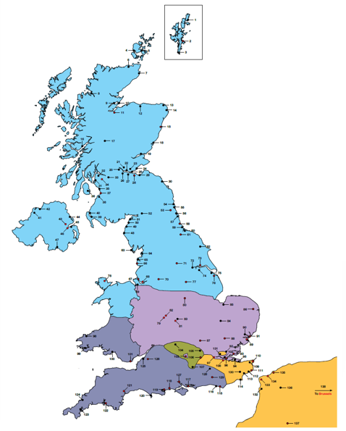
Roll-On/Roll-Off Ports
  Implications for all ~135 UK ports and airports
  Many airports and deep sea ports already handle ROW
  goods- customs systems and infrastructure
  Biggest impacts for RoRo ports, especially
  Short Straits and key East coast routes – volumes, frequency, flexibility
    Just-in-time and just-in-sequence supply chains integrated between EU and UK
  Critical for trade, business continuity, local and national economies, continuity of critical goods such as food and medicines

Slide 6
RoRo Model – key principles
  Day 1
  Declarations should be lodged electronically in advance, including any safety and security declarations; and
  Routine fiscal and other controls and checks undertaken away from the flow of traffic
  Longer-term
  Longer term, UK government is working on automated solutions, use of technology for smarter borders and sharing more data

Slide 7



Importing goods through RoRo borders on ‘Day 1’
overall_0_131890129951127481 columns_2_131889998625156500 6_1_131889998640165249 9_1_131889998640376058 25_1_131890006548949768 30_1_131890010047522118 33_1_131890010222844276 37_1_131890018140189422 38_1_131890029732408871 44_1_131890068567785038 27_1_131890129739223457
customs
Pre-border
En route
At UK border
Register for EORI
Goods free to leave
Pre-lodge import declaration to UK Government
Master Reference Number (MRN) or EORI provided to haulier/freight forwarder
Update status of customs to show goods arrived in UK
Risk-based checks, no change from current approach
Goods held
Businesses can defer payment if:
Paying customs in monthly payments
Using special relief schemes
Duties paid or deferred
Key: Responsible parties
Business
Haulier
UK Government

Slide 8
Exporting goods through RoRo borders on ‘Day 1’
overall_0_131890129951127481 columns_2_131889998625156500 6_1_131889998640165249 9_1_131889998640376058 25_1_131890006548949768 30_1_131890010047522118 33_1_131890010222844276 37_1_131890018140189422 38_1_131890029732408871 44_1_131890068567785038 27_1_131890129739223457 14_1_131914602241601124
Customs and safety/security
exports
Authorised
premise/DEP
Pre-departure
At UK border
Post border
Submit combined Export/ Safety & Security Declaration
Document checks – response provided to exporter
Permission to proceed granted
High risk goods: Obtain full departure message from HMRC or intermediary
Haulier checks in for boarding and takes goods to departure point
Pre-lodge any supporting documents on relevant system(s)
Exporter tells haulier if Permission to Proceed granted or need to take goods to Designated Export Point (DEP)
Haulier takes goods to DEP; Checks carried out if necessary and Declaration updated
Ferry/train departs
Key: Responsible parties
Business
UK Government

Slide 9
Transit and the Common Transit Convention (CTC)
CTC facilitates the movement of goods across borders of member countries by only requiring customs declarations and payment of duties when goods arrive at their final destination
The UK is a member of the CTC now, and will continue to be a member once we have left
the EU
The requirements for traders will be similar to now, with the additional requirement of scanning a Transit Accompanying Document at the point of entry into the UK (or into the EU when exporting)
Businesses who currently or may wish to use the transit regime may want to consider:
  registering to use NCTS, which is the system used for moving goods under transit
  registering as an Authorised Consignor/Consignee to allow them to start and end transit movements from their own premises
  expanding existing or adding new Authorised Consignor/Consignee facilities

Slide 10

Key Actions for Businesses
Businesses who only trade with the EU need to act now to ensure that they are prepared in the event of a No Deal EU exit
Apply for an EORI number
Confirm you can complete each data field in the Declaration
Agree responsibilities with your customs agent and logistics provider for each part of the process and update your contracts to reflect this
Identify software for submitting documents, if you do not use a customs agent

Slide 11
VAT Update

Slide 12
Overview
If the UK leaves the EU without a deal, the government’s aim will be
to keep VAT processes as close as possible to now
However, there will be some changes that will affect businesses
We have taken steps to mitigate the impact of changes where we can
We want to help businesses understand what they need to do, and help them to do it, so they can continue trading smoothly

Slide 13
What’s changing?
In a no deal scenario, postponed accounting will be introduced
for imports from the EU and Rest of World
Business will not need to register to use postponed accounting. They will simply make the appropriate entry and provide their VAT registration number on their customs declaration
An online monthly statement will show the VAT that’s been postponed. This will provide the evidence to declare/ recover import VAT on your VAT return
Postponed accounting won’t be available for postal goods of £135 or less
Postponed accounting won’t be available for non-VAT registered businesses

Slide 14
What’s changing?
For parcels sent by overseas businesses, Low Value Consignment Relief will be abolished, and an online service will collect VAT from businesses for parcels up to £135
We are working with stakeholders to help businesses be compliant and parcel operators adjust to the new processes
We’ve updated the EU Exit Partnership Pack with more guidance on the service and rules around VAT
The parcels service will be available soon for businesses to register online

Slide 15
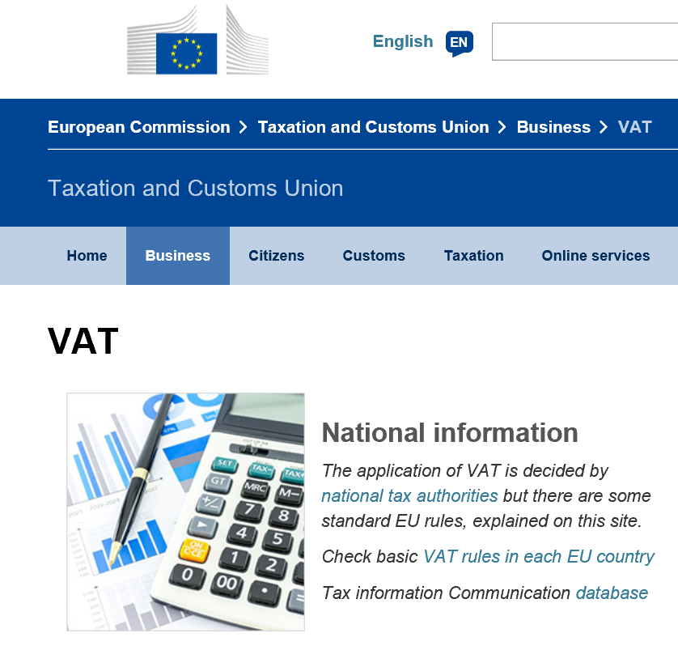
What’s changing?
We expect EU member states will apply Rest of World rules to the UK
for exports and other EU VAT processes
For exports, businesses no longer need to complete EC sales lists, but will need to review the rules in individual member states that apply for import VAT
The UK would stop having access to certain EU VAT IT systems – but a new UK VAT registration number
checker will be available
For tour operators that use the EU ‘TOMS’ scheme,
our aim is to keep rules as close as possible to now

Slide 16
We are starting to lay secondary legislation as part of preparations for no deal
Statutory Instrument | Date Laid
The Value Added Tax (Disclosure of Information Relating to VAT Registration) (EU Exit) Regulations 2018 | 27 November 2018
The Value Added Tax (Postal Packets and Amendment) (EU Exit) Regulations 2018 | 18 December 2018
The VAT (Finance) (EU Exit) Order 2019 | 17 January 2019
The Value Added Tax (Tour Operators) (Amendment) (EU-Exit) Regulations 2019 | 22 January 2019
The Value Added Tax (Miscellaneous Amendments and Revocations) (EU Exit) Regulations 2019 | 22 January 2019
The Value Added Tax (Accounting Procedures for Import VAT for VAT Registered Persons and Amendment) (EU Exit) Regulations 2019 | 22 January 2019
Taxation (Cross-border Trade) Act 2018 (Value Added Tax Transitional Provisions) (EU Exit) Regulations 2019 | Made 24 January 2019
Value Added Tax and Excise Personal Reliefs (Special Visitors and Goods Permanently Imported) (Amendment) (EU Exit) Regulations 2019 | 24 January 2019

Slide 17
For action
If you currently use Mini One Stop Shop or the EU VAT refund system please prepare your businesses by reading the guidance on IT systems on GOV.UK (coming soon)
Familiarise yourselves with the statutory instruments which you can read on GOV.UK or Legislation.gov.uk
If you want to understand how postponed accounting will operate please keep abreast of additions to the guidance on GOV.UK

Slide 18
Excise Update

Slide 19
Background
Currently, businesses can transport excise goods (except some oils), across borders within the EU and in the UK in duty suspense
Businesses don’t need to pay excise duty until goods are released for sale
in the home market at their final destination
Duty suspended movements are tracked using the pan-EU Excise Movement and Control System (EMCS)
Duty paid movements are controlled by manual documentation
(Simplified Accompanying Administrative Document – SAAD)
Businesses can reclaim excise duty on goods not consumed in the UK
(Excise Drawback system)

Slide 20
What's changing – no deal scenario - imports
Rest of World rules will apply to imports of excise goods from the EU
What this means
UK businesses will need to make an import declaration and:
  account for the excise duty at the border; or
  enter to the goods to the excise warehousing regime via EMCS (Excise Movement Control System)
  UK businesses can use Customs procedures for EU goods, e.g. Customs Warehousing, Transit etc. This will increase the volumes of goods at risk under customs control
  Businesses can continue to use EMCS to move goods in duty suspense in the UK from the port to a registered warehouse
  The Registered Excise Dealers and Shippers system (REDs) will be obsolete and shut down
Notes:
The Government is confident it will secure an ambitious and comprehensive future partnership with the EU, delivering a close economic and security relationship that is in the interests of both the UK and the EU.
While the Government is confident of reaching a deal, a responsible government has a duty to prepare for all possible outcomes, including the unlikely scenario the UK leaves the EU on 29 March 2019 with no agreement in place.

Slide 21
What's changing - no deal scenario - exports
Rest of World rules will apply to exports of excise goods to the EU
What this means
  Businesses will need to make an export declaration at the point of exit from the UK
  Businesses can continue to use EMCS to move goods under duty suspension in the UK
  from a registered warehouse to the port/airport of departure
  EMCS will be restricted to movements within the UK
  Businesses will be able to claim Excise Duty Drawback on goods not consumed in UK
  (will include exports to the EU)
  Businesses will need to make an import declaration on entry of the goods into the EU
Notes:
The Government is confident it will secure an ambitious and comprehensive future partnership with the EU, delivering a close economic and security relationship that is in the interests of both the UK and the EU.
While the Government is confident of reaching a deal, a responsible government has a duty to prepare for all possible outcomes, including the unlikely scenario the UK leaves the EU on 29 March 2019 with no agreement in place.

Slide 22
What's changing - no deal scenario – excise systems
Changes to EMCS
  Switch off EMCS messaging to EU
  Restrict movements to EU
Impact on excise customers who don’t currently import or export to Rest of World
  Businesses will need an EORI number
  Importers will need access to a Registered Consignor

Slide 23
What's changing - no deal scenario - legislation
3 Excise Statutory Instruments laid on 15 January
  The Excise Goods (Holding, Movement and Duty Point) (Amendment)
  (EU Exit) Regulations 2019
  The Excise Duties (Miscellaneous Amendments) (EU Exit) Regulations 2019
  The Excise Duties (Miscellaneous Amendments) (EU Exit) (No 2) Regulations: 2019
Further excise secondary legislation planned for March
Notes:
HMDP
The SI establishes the rules for the holding and movement of excise goods into, out of and within the UK.
In particular, it regulates and provides clarity on:
The arrival of goods from the EU – excise duty point etc.
Definitions that are no longer relevant
Concepts that are being repealed or removed
Misc
Makes miscellaneous changes to:
The Excise Duties (Personal Reliefs) (Fuel and Lubricants Imported in Vehicles) (Amendment) (EU Exit) Order
The Travellers’ Reliefs (Fuel and Lubricants) (Amendment) (EU Exit) Order
The Excise Goods (Drawback) (Amendment) Regulations
Misc 2
Miscellaneous changes to:
The Denatured Alcohol (Amendment) (EU Exit) Regulations
The Duty Stamps (Amendment) (EU Exit) Regulations
The Excise Warehousing (Energy Products) (Amendment) (EU Exit) Regulations
The Excise Warehousing (etc) (Amendment) (EU Exit) Regulations
The Hydrocarbon Oil Duties (Marine Voyages Reliefs) (Amendment) (EU Exit) Regulations
The Spirits (Amendment) (EU Exit) Regulations
The Tobacco Products (Amendment) (EU Exit) Regulations
The Warehousekeepers and Owners of Warehoused Goods (Amendment) (EU Exit) Regulations

Slide 24
Guidance and support
Existing EU Exit guidance
  Customs and Excise Technical Notice (issued August 2019)
  EMCS Software specification (issued September 2019)
Changes to excise forms (February/March)
Guidance
  Changes to excise public notices
  GOV.UK content
Engagement with excise businesses
  Day one readiness
  Separation Issues
  Secondary legislation
  Long term policy opportunities

Slide 25
For action
Businesses and software developers need to make the necessary changes to excise IT systems – EMCS
Businesses need to get access to a Registered Consignor if they need one to enter goods onto EMCS
Businesses need to complete day one customs arrangements – obtain EORI number for customs declarations from HMRC, get access to an agent
Businesses need to familiarise themselves with the changes to excise processes – legislation, public notices, guidance and forms

Slide 26
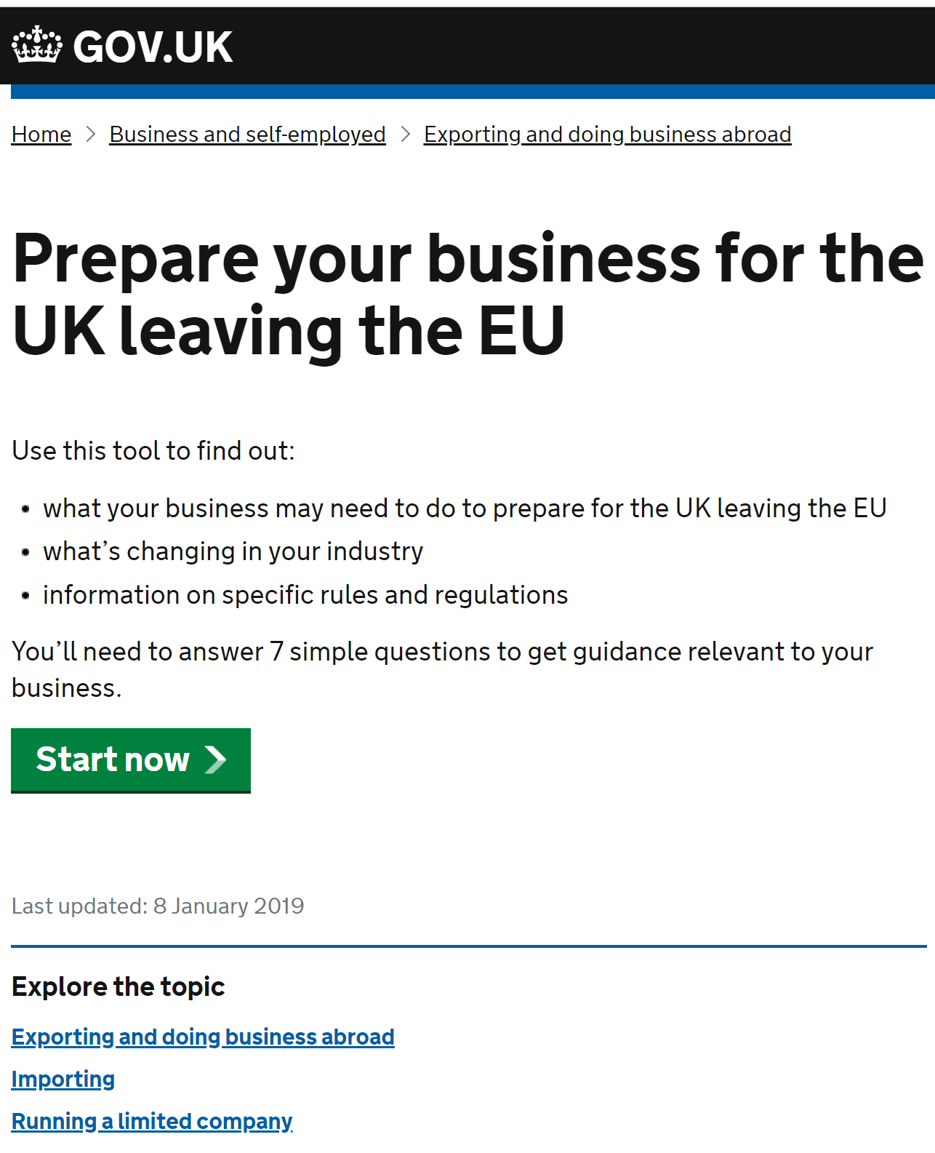
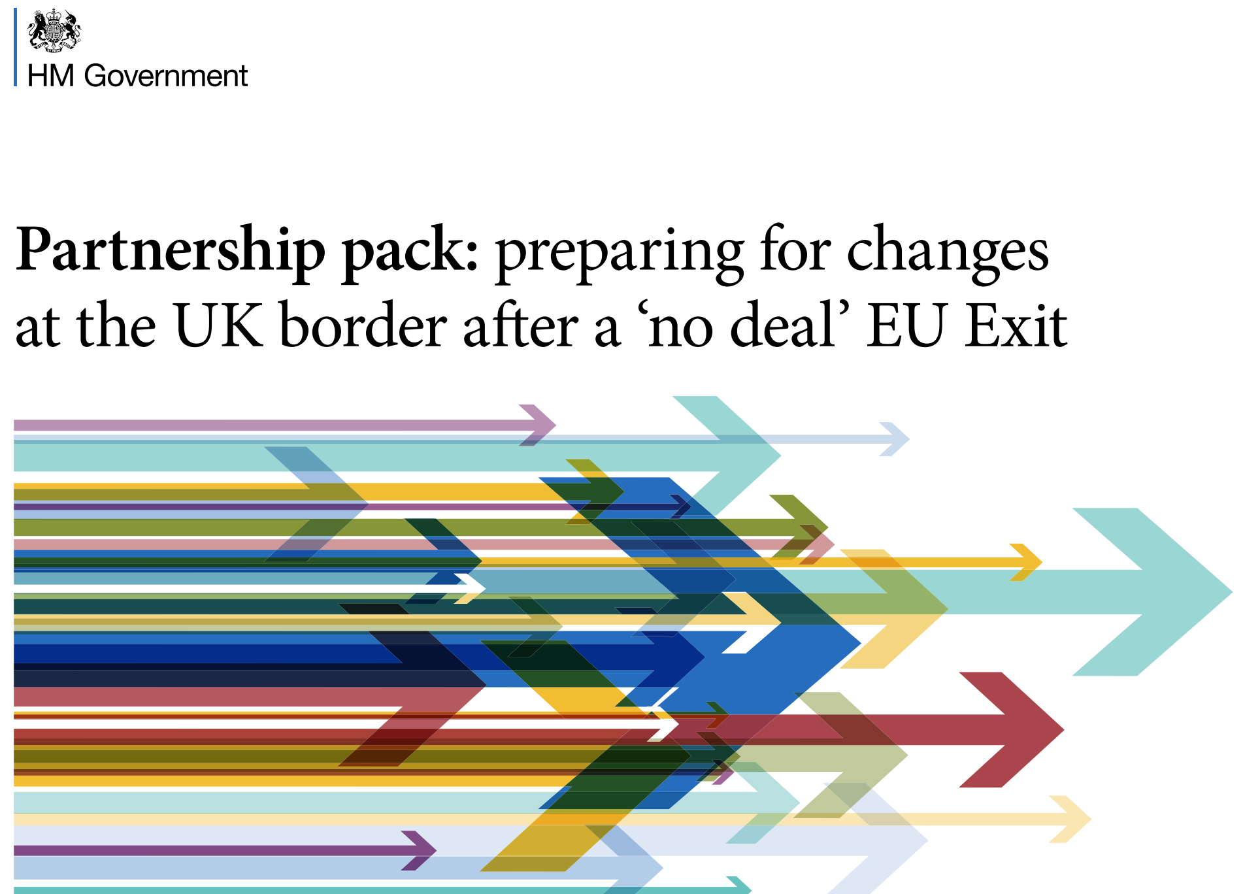
More ‘no deal’ guidance is coming soon
The full range of information on customs, VAT and excise after EU Exit, and more technical guidance for stakeholders, will be on GOV.UK and other comms channels.

